Slide 1
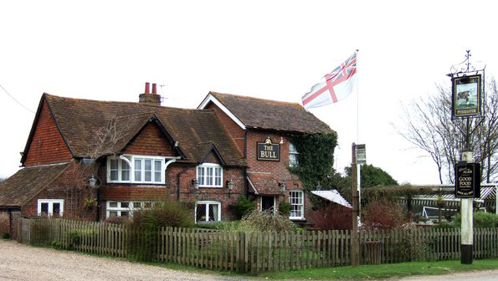
Save The Bull at Bellingdon Meeting 7.30pm Thursday 12th January 2017
www.bellingdon.com

Slide 2
Background
The Pub is the only one in the village and was a very important hub of the community
www.bellingdon.com
www.bellingdon.com

Slide 3
Background
Previous owners Fortitude submit first planning
application for re - development - 2008
The ‘Save The Bull’ group of volunteers set up
and receives a remit to represent the village - Late 2009
A set of plans is accepted by the CDC - Late 2010
Fortitude put ‘The Bull’ up for sale before development - Late 2011
New owners are the Matthews Family - Early 2012
The owners obtain a temp 3 yr. licence for a nursery - July 2014
Save The Bull group successful in registering ‘The Bull’
as a community asset - Sept 2014

Slide 4
Background
Living near a pub makes you happier!
People are found to be significantly happier, have more friends, better life satisfaction and less likely to drink to excess.
Source – Oxford University research - 2016
www.bellingdon.com

Slide 5
Background
“A good local pub makes a village more attractive and can have a positive impact on houses prices”
Research found that almost a quarter of homebuyers like to be near a local pub
Source – Tepilo Estate Agents - 2015
www.bellingdon.com

Slide 6
If I want to continue to receive information what should I do?
Send your email details (if you haven’t done so already) to:
contact@bellingdon.com
we will keep you informed by email.
Also follow details on www.Bellingdon.com

Slide 7
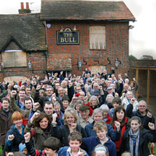
Thanks for your support!
Photograph:
November 2009.
Over 130 villagers show their support for ‘The Bull’
Subsequent meetings have had similar support
www.bellingdon.com

